Slide 1



TESTING AND DEPLOYMENT
DATABRICKS DATA ENGINEER PROFESSIONAL CERTIFICATION
SARA IRFAN

Slide 2

OUTLINE
EXPLORING THE NOTEBOOK
CREATE PYTHON FILE IN DATABRICKS REPOS
IMPORT AND USE THE NEW CLASS
IMPORT FROM EXTERNAL MODEULE
INSTALLING PYTHON WHEELS

Slide 3
USING THE PYTHON IMPORTS
Using Python Imports:
Replace %run magic command with Python imports.
Attempt Import:
Try importing the Cube class directly using Python syntax.

Slide 4
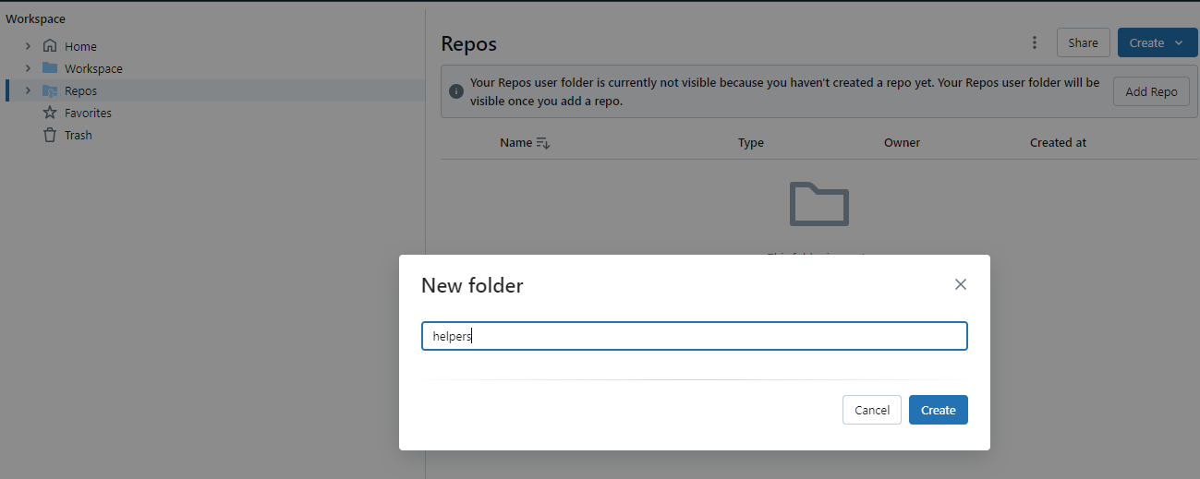
CREATE A DIRECTORY HELPERS UNDER REPOS OF DATABRICKS WORKSPACE

Slide 5
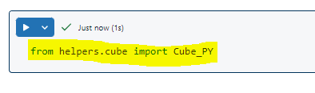
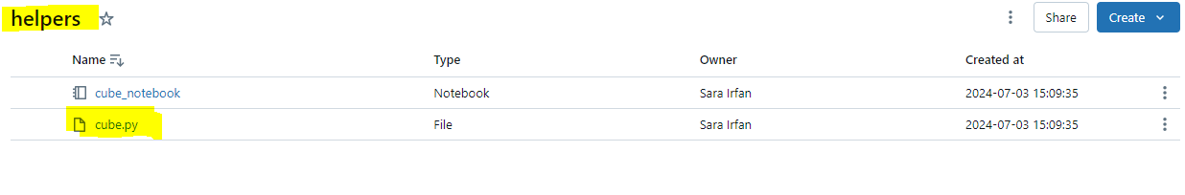
CREATE PYTHON FILE IN DATABRICKS REPOS
Enable File Creation:
Go to the admin console.
Under workspace settings, enable "Files in Repos"
Create cube.py File:
In the helpers folder, create a file named cube.py.
Paste the Cube class code into this file,
renaming it to Cube_PY for distinction.

Slide 6
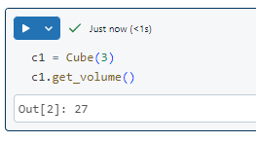
EXPLORE THE NOTEBOOK
Cube Class Definition:
Define a Cube class with a constructor that accepts
one argument (the edge of the cube).
Include methods to calculate the cube's volume and surface area.
Run Initial Setup:
Execute the cell to make all local objects
(functions, variables, classes) from the
reference notebook available

Slide 7
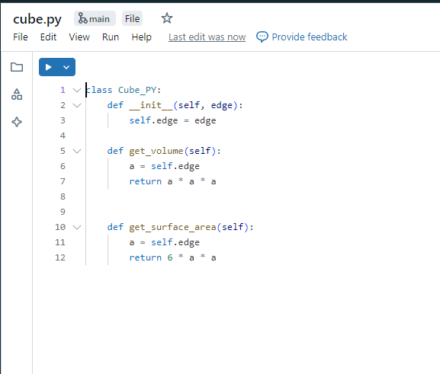
IMPORT AND USE THE NEW CLASS
Import the Class:
Use from helpers.cube import
Cube_PY to
import the class from the new
Python file.
Run and Verify:
Run the cell and create an
instance of
Cube_PY to confirm the import
works.

Slide 8
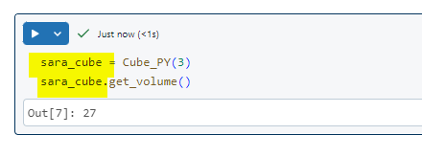
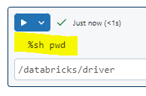
WORKING DIRECTORY AND PYTHON PATH
The content of the notebook and the Python file
might look identical, but notebooks contain a special
comment
Use shell commands (e.g., %pwd, %ls) to confirm
the current working directory.
Use sys.path.append() to add directories to the
Python path for importing modules from outside the current directory.

Slide 9
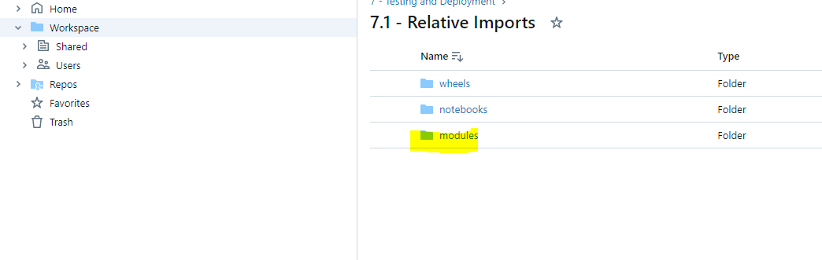

Slide 10
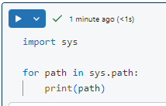
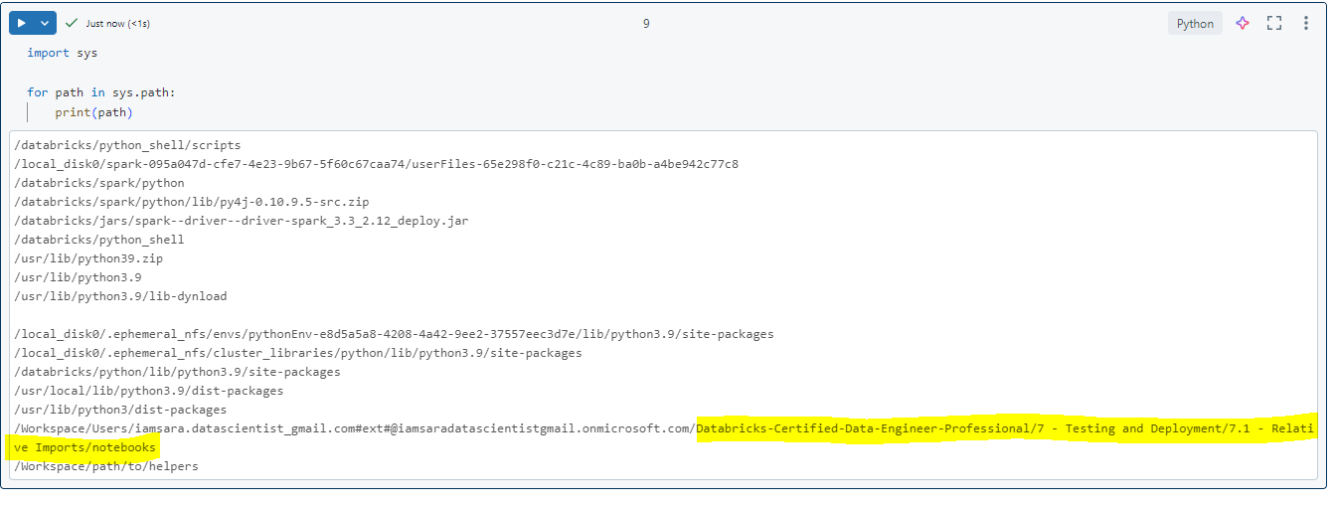
IMPORTING SYSTEM

Slide 11

IMPORT FROM EXTERNAL MODULES
Import from Modules Directory:
Append the modules directory to the Python path.
Import the class from the shapes package in the modules directory and confirm it works.

Slide 12
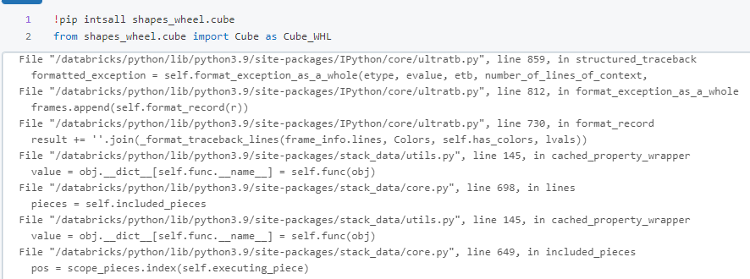
INSTALLING PYTHON WHEELS
Python Wheels(Allows Faster
Installation, Compiled )
Install prebuilt binary packages using
the %pip magic command.
Place %pip install commands at
the beginning

Slide 13

CONCLUSION
Covered replacing %run magic command
with relative imports, creating and using Python files,
managing Python paths, and installing Python wheels.
Encourage learners to apply these techniques
for better code management in Databricks.

Slide 14

FEEL FREE TO CONTACT ME
SARA IRFAN
EMAIL: Sara.data.insights@gmail.com

